Slide 1
Capstone project - KPMG
SPEND ANALYTICS – PRODEGREE DATASCIENCE PROJECT 2021

Slide 2
Objective:
Analyze the data and identify purchasing trends and patterns
Identify the cost saving opportunities by using the data of procurement
Cluster items that have similar purchasing patterns
Forecasting the data based on available data
Create dashboards using any Visualization tool; e.g. Tableau
Make a report describing all the findings.

Slide 3
Important Variables
Important Variables:
S.No | Variable Name | Type | SAP reference | Description | Category
1 | Changed On | object | - | Changes made on the Purchase order | Default
2 | Short Text | object | TXZ01 | Description | Default
3 | CoCd | int64 | BUKRS | organisation code | Default
4 | Plnt | object | WERKS | Plant Code- who has send the requirement | Default
5 | Matl Group | object | MATKL | Material Group | Default
6 | PO Quantity | object | MENGE | distribute to this account assignment item | Default
7 | Net Price | object | NETPR | Net Order Price information | Default
8 | Net Value | object | NETWR | net value of the item, after any discounts and surcharges are taken into account | Default
9 | Gross value | object | BRTWR | Gross order value information. Order value = order quantity X order price. | Default
10 | Date | object | - | Date | User Defined
11 | Year | int64 | - | Year | User Defined
12 | Qtr | int64 | - | Quarter | User Defined
13 | Month | object | - | Month | User Defined
14 | Day | int64 | - | Day | User Defined
15 | Yr_Mn | object | - | Year and Month | User Defined
16 | Mn_val | int64 | - | Month_value | User Defined
17 | Yr_Mn_val | object | - | Year_Month_Value | User Defined
18 | Yr_Mn_val1 | object | - | Year_(Month_val)_Month | User Defined
19 | Yr_Qtr | object | - | Year_Quarter | User Defined
20 | week | object | - | Week | User Defined
21 | Gross value_1 | float64 | BRTWR | Gross order value information. Order value = order quantity X order price. | User Defined
22 | PO Quantity_1 | float64 | MENGE | distribute to this account assignment item | User Defined
23 | Net Price_1 | float64 | NETPR | Net Order Price information | User Defined
24 | Gross per POQ | float64 | - | Gross order value per PO Quantity | User Defined
Above 24 variables are considered as important for analysis
Date,Year,Qtr,Month,Day,Yr_Mn,Mn_val,Yr_Mn_val,Yr_Mn_val1,Yr_Qtr,week variables are created as part of feature engineering which will be useful for EDA

Slide 4
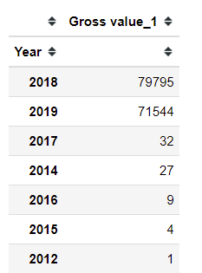
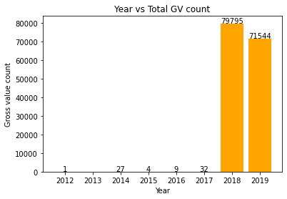
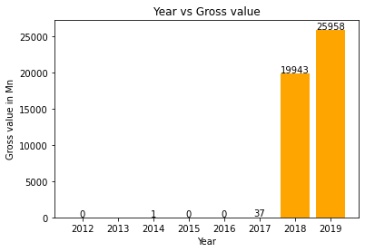
Year vs Values Spent
Year | Gross_Value | No of Entries
2012 | 0.002 | 1
2014 | 0.592 | 27
2015 | 0.006 | 4
2016 | 0.144 | 9
2017 | 37.361 | 32
2018 | 19943.371 | 79795
2019 | 25957.576 | 71544
Total | 45939.052 | 151412
Major spend observed in 2018 and 2019
Though number of spends are high in 2018 , More money spent in 2019

Slide 5
Prescriptive Analytics – Data Visualization

Slide 6
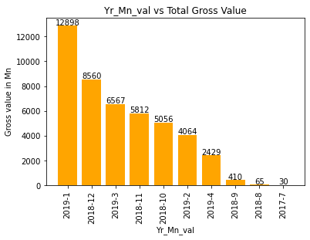
Year-Month-Relationship
Row index | Year-Month | Gross value | GV_Count
0 | 2012-(7)-Jul | 0.002 | 1
1 | 2014-(12)-Dec | 0.034 | 7
2 | 2014-(4)-Apr | 0 | 1
3 | 2014-(6)-Jun | 0.545 | 2
4 | 2014-(8)-Aug | 0.012 | 17
5 | 2015-(2)-Feb | 0.006 | 3
6 | 2015-(8)-Aug | 0 | 1
7 | 2016-(9)-Sep | 0.144 | 9
8 | 2017-(10)-Oct | 0.1 | 4
9 | 2017-(11)-Nov | 0.058 | 1
10 | 2017-(12)-Dec | 0.153 | 6
11 | 2017-(5)-May | 7.062 | 13
12 | 2017-(7)-Jul | 29.628 | 5
13 | 2017-(8)-Aug | 0.354 | 2
14 | 2017-(9)-Sep | 0.007 | 1
15 | 2018-(1)-Jan | 0.168 | 3
16 | 2018-(2)-Feb | 0.106 | 6
17 | 2018-(3)-Mar | 0.095 | 32
18 | 2018-(4)-Apr | 3.834 | 12
19 | 2018-(5)-May | 4.537 | 43
20 | 2018-(6)-Jun | 3.147 | 38
21 | 2018-(7)-Jul | 27.862 | 68
22 | 2018-(8)-Aug | 65.479 | 166
23 | 2018-(9)-Sep | 410.359 | 2035
24 | 2018-(10)-Oct | 5055.736 | 24272
25 | 2018-(11)-Nov | 5811.807 | 24989
26 | 2018-(12)-Dec | 8560.241 | 28131
27 | 2019-(1)-Jan | 12898.02 | 27411
28 | 2019-(2)-Feb | 4063.626 | 22192
29 | 2019-(3)-Mar | 6567.139 | 21423
30 | 2019-(4)-Apr | 2428.788 | 518
Total | 31 | 45939.05 | 151412
In 7 years spend occurred in 31 months
In 31 months 6 months having major spending with >20k entries and following 2K and 0.5K spends each month respectively
With maximum number of spends ,occurs maximum amount spent in these months
Jan-2019 contributes highest spend in all these 7 years with 31 months

Slide 7
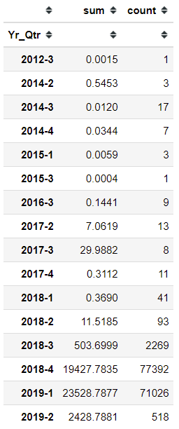
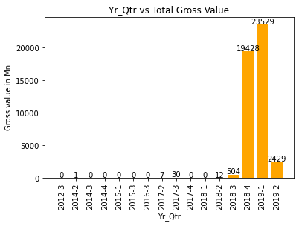
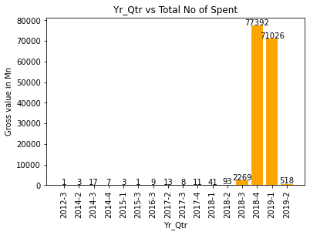
Quarterly Spend
Major spend observed in Q4 of 2018 and Q1 of 2019. Also in Q2 of 2019 2K Mn spend happened

Slide 8
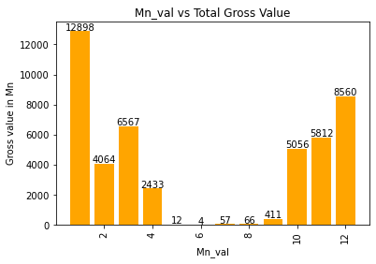
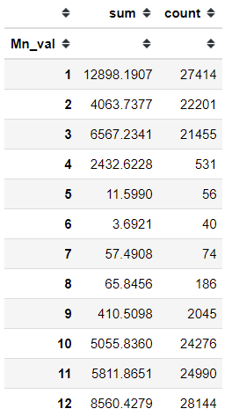
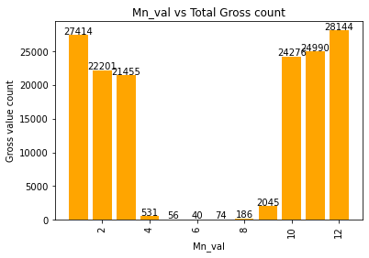
Monthly Spend
In Cumulative_sum of all months ,Major spend observed between Oct to Mar.
Jan month showing very high value

Slide 9
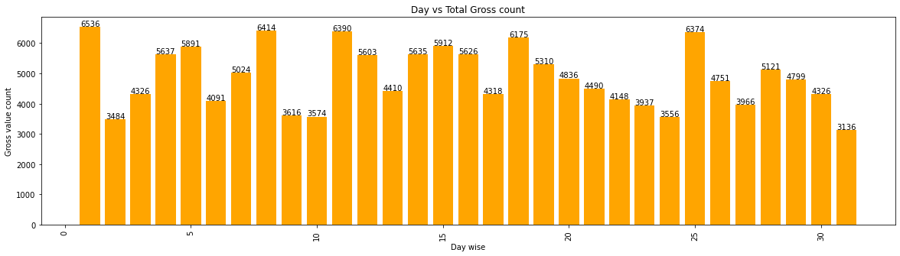
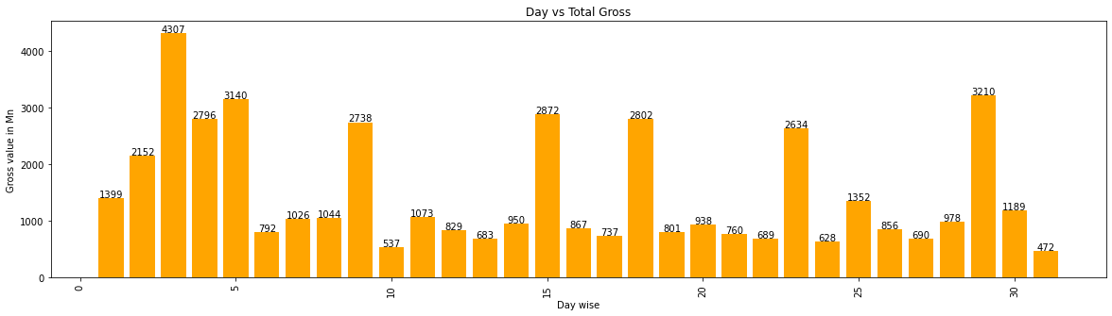
Day wise Spend
Day wise | No of spent | Gross Value in Mn
1 | 6536 | 1399
2 | 3484 | 2152
3 | 4326 | 4307
4 | 5637 | 2796
5 | 5891 | 3140
6 | 4091 | 792
7 | 5024 | 1026
8 | 6414 | 1044
9 | 3616 | 2738
10 | 3574 | 537
11 | 6390 | 1073
12 | 5603 | 829
13 | 4410 | 683
14 | 5635 | 950
15 | 5912 | 2872
16 | 5626 | 867
17 | 4318 | 737
18 | 6175 | 2802
19 | 5310 | 801
20 | 4836 | 938
21 | 4490 | 760
22 | 4148 | 689
23 | 3937 | 2634
24 | 3556 | 628
25 | 6374 | 1352
26 | 4751 | 856
27 | 3966 | 690
28 | 5121 | 978
29 | 4799 | 3210
30 | 4326 | 1189
31 | 3136 | 472
Grand Total | 151412 | 45939
In Cumulative_sum of all days ,Major spend observed on 3rd day
Jan month showing very high number of spends

Slide 10
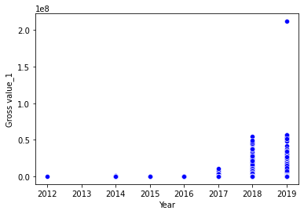
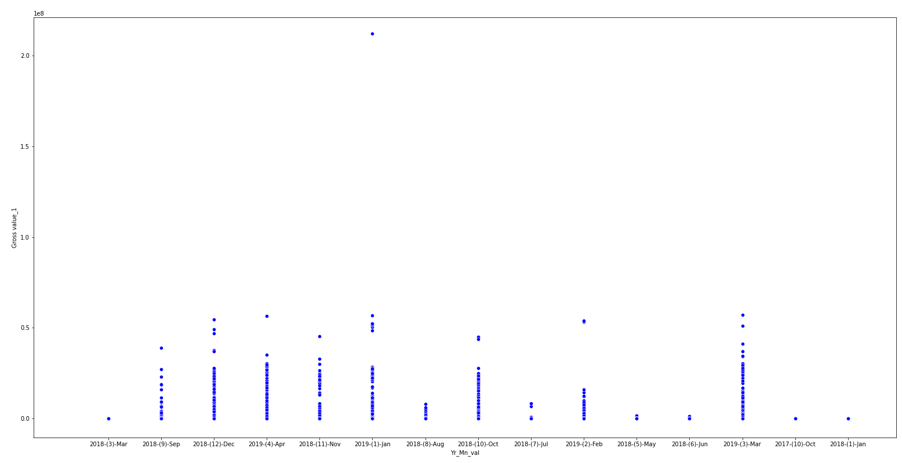
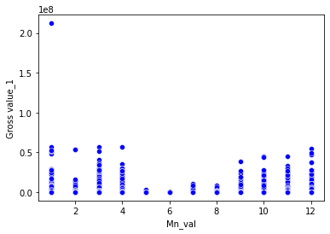
Outlier Detection
Observed one high value(outlier) during Jan’2019
Maximum value spent between 2019 and 2018 are (212.0, 54.76)Mn respectively which shows huge difference

Slide 11
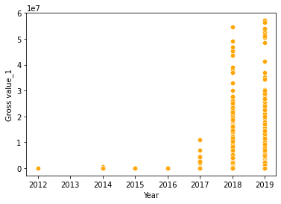
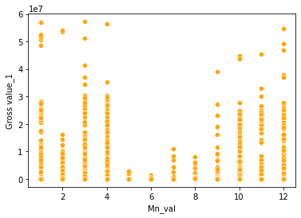
Distribution-pre_post removal of outlier
Distribution looks different with removal of outlier

Slide 12
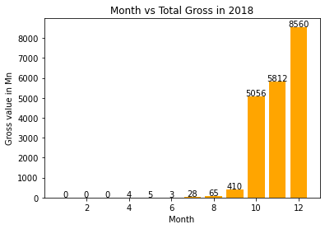
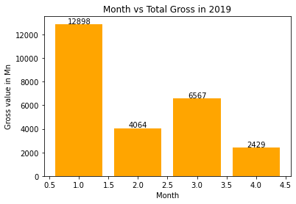
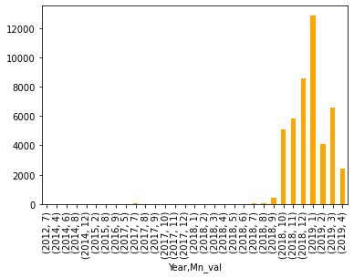
Year Month Distribution
Row index | Year-Month | Gross value | GV_Count
0 | 2012-(7)-Jul | 0.002 | 1
1 | 2014-(12)-Dec | 0.034 | 7
2 | 2014-(4)-Apr | 0 | 1
3 | 2014-(6)-Jun | 0.545 | 2
4 | 2014-(8)-Aug | 0.012 | 17
5 | 2015-(2)-Feb | 0.006 | 3
6 | 2015-(8)-Aug | 0 | 1
7 | 2016-(9)-Sep | 0.144 | 9
8 | 2017-(10)-Oct | 0.1 | 4
9 | 2017-(11)-Nov | 0.058 | 1
10 | 2017-(12)-Dec | 0.153 | 6
11 | 2017-(5)-May | 7.062 | 13
12 | 2017-(7)-Jul | 29.628 | 5
13 | 2017-(8)-Aug | 0.354 | 2
14 | 2017-(9)-Sep | 0.007 | 1
15 | 2018-(1)-Jan | 0.168 | 3
16 | 2018-(2)-Feb | 0.106 | 6
17 | 2018-(3)-Mar | 0.095 | 32
18 | 2018-(4)-Apr | 3.834 | 12
19 | 2018-(5)-May | 4.537 | 43
20 | 2018-(6)-Jun | 3.147 | 38
21 | 2018-(7)-Jul | 27.862 | 68
22 | 2018-(8)-Aug | 65.479 | 166
23 | 2018-(9)-Sep | 410.359 | 2035
24 | 2018-(10)-Oct | 5055.736 | 24272
25 | 2018-(11)-Nov | 5811.807 | 24989
26 | 2018-(12)-Dec | 8560.241 | 28131
27 | 2019-(1)-Jan | 12898.02 | 27411
28 | 2019-(2)-Feb | 4063.626 | 22192
29 | 2019-(3)-Mar | 6567.139 | 21423
30 | 2019-(4)-Apr | 2428.788 | 518
Total | 31 | 45939.05 | 151412
Only 4 months data available in 2019 and same time purchase in very high
when compared to 2018

Slide 13
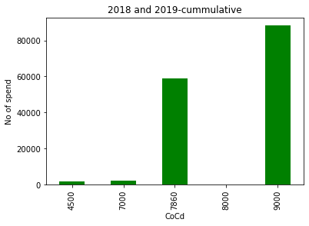
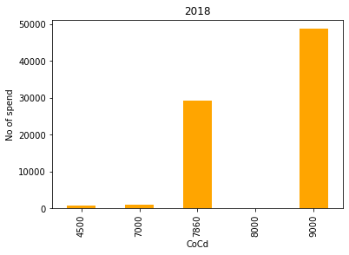
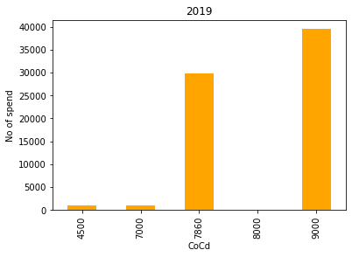
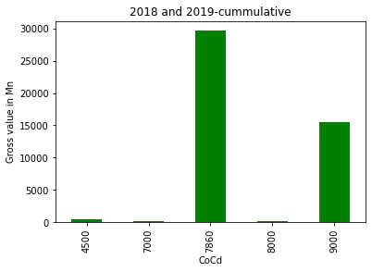
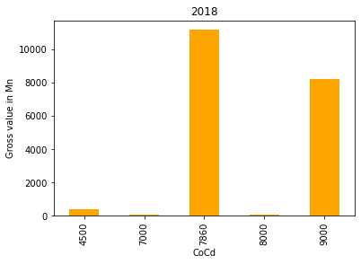
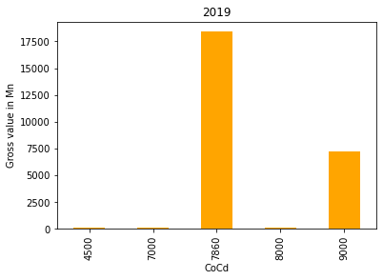
Comparison between no of spend with Gross value spent
Though no of items purchased are high in CoCd 9000 ,amount spent is high in 7860

Slide 14
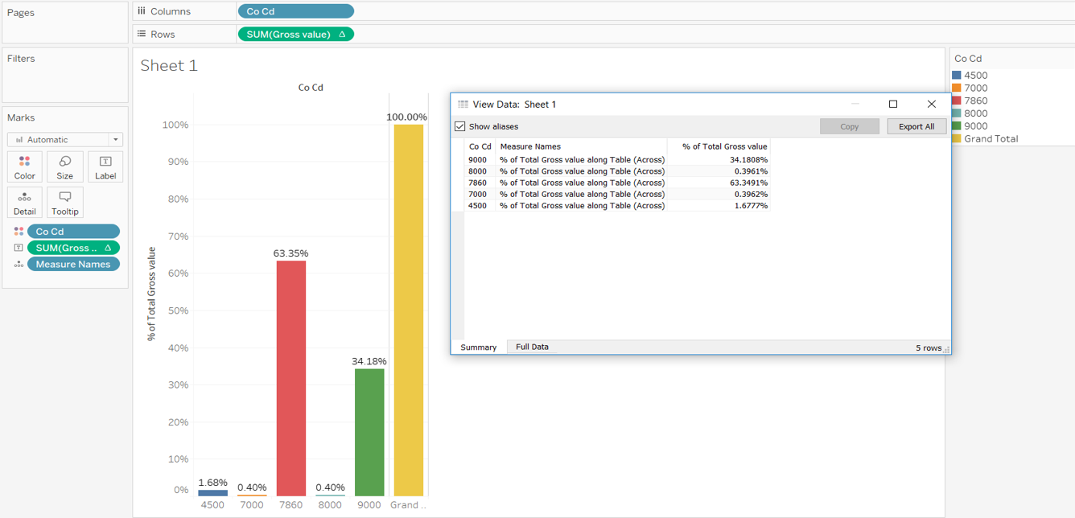
Based on Cocd -Spend
7860 CoCd contributed maximum in Gross value with 63.34% followed by 9000 with 34.18%

Slide 15
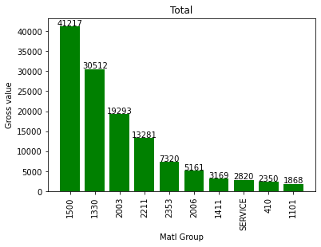
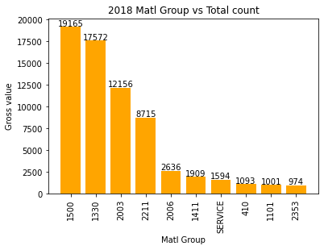
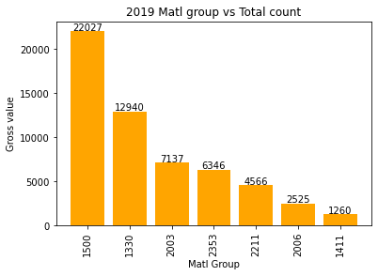
Material Group bifurcation-No of spent
1500 is the material group with maximum contribution

Slide 16
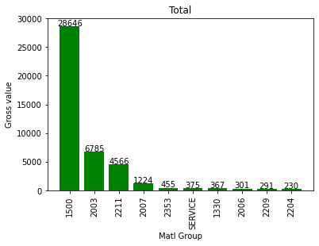
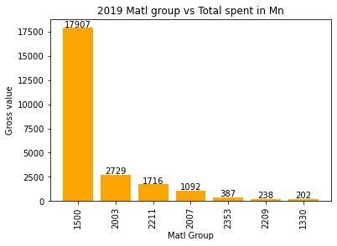
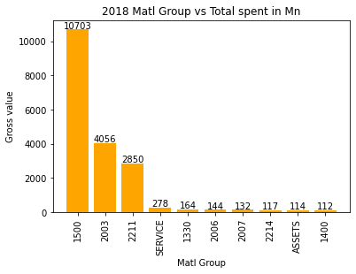
Material Group bifurcation-Spent in Mn
1500 is the material group with maximum contribution

Slide 17
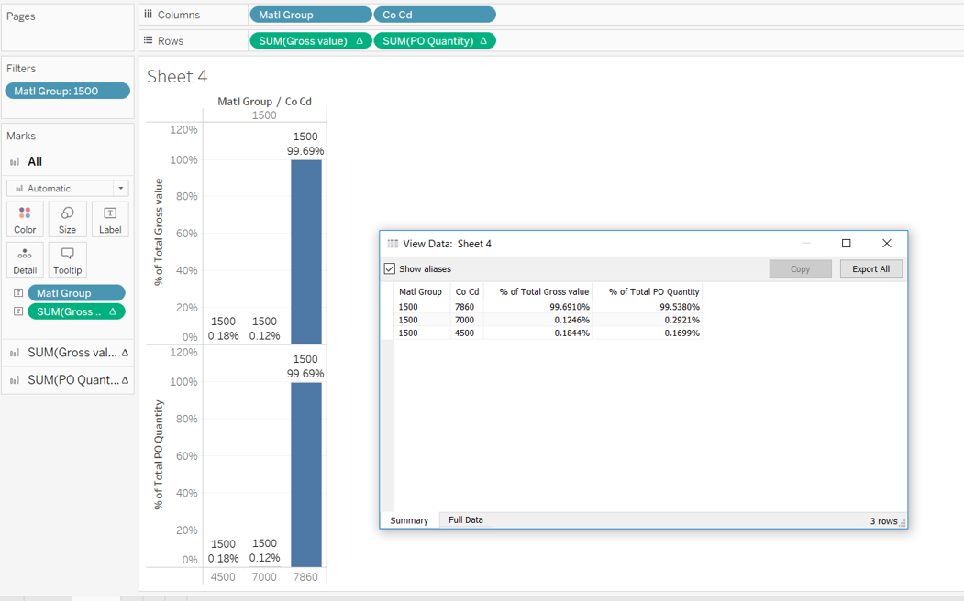
Based on Material Group(1500) -Spend
1500 Material Group contributed maximum in Gross value of 7860 Cocd group

Slide 18
Top spend on Matl_Group
Index | Year | Matl_Group | No of Spend
0 | 2019 | 1500 | 22027
1 | 2018 | 1500 | 19165
2 | 2018 | 1330 | 17572
3 | 2019 | 1330 | 12940
4 | 2018 | 2003 | 12156
5 | 2018 | 2211 | 8715
6 | 2019 | 2003 | 7137
7 | 2019 | 2353 | 6346
8 | 2019 | 2211 | 4566
9 | 2018 | 2006 | 2636
10 | 2019 | 2006 | 2525
11 | 2018 | 1411 | 1909
12 | 2018 | SERVICE | 1594
13 | 2019 | 1411 | 1260
14 | 2019 | 410 | 1257
Index | Year | Matl_Group | Gross value in Mn
0 | 2019 | 1500 | 17906.76
1 | 2018 | 1500 | 10702.57
2 | 2018 | 2003 | 4056.01
3 | 2018 | 2211 | 2850.27
4 | 2019 | 2003 | 2728.80
5 | 2019 | 2211 | 1715.52
6 | 2019 | 2007 | 1092.49
7 | 2019 | 2353 | 386.72
8 | 2018 | SERVICE | 278.06
9 | 2019 | 1330 | 202.33
10 | 2018 | 1330 | 164.32
11 | 2019 | 2006 | 156.69
12 | 2018 | 2006 | 144.46
13 | 2019 | 2204 | 143.84
14 | 2018 | 2007 | 131.96

Slide 19
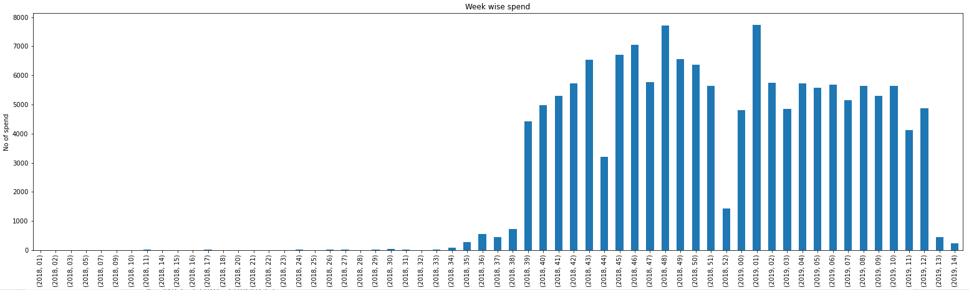
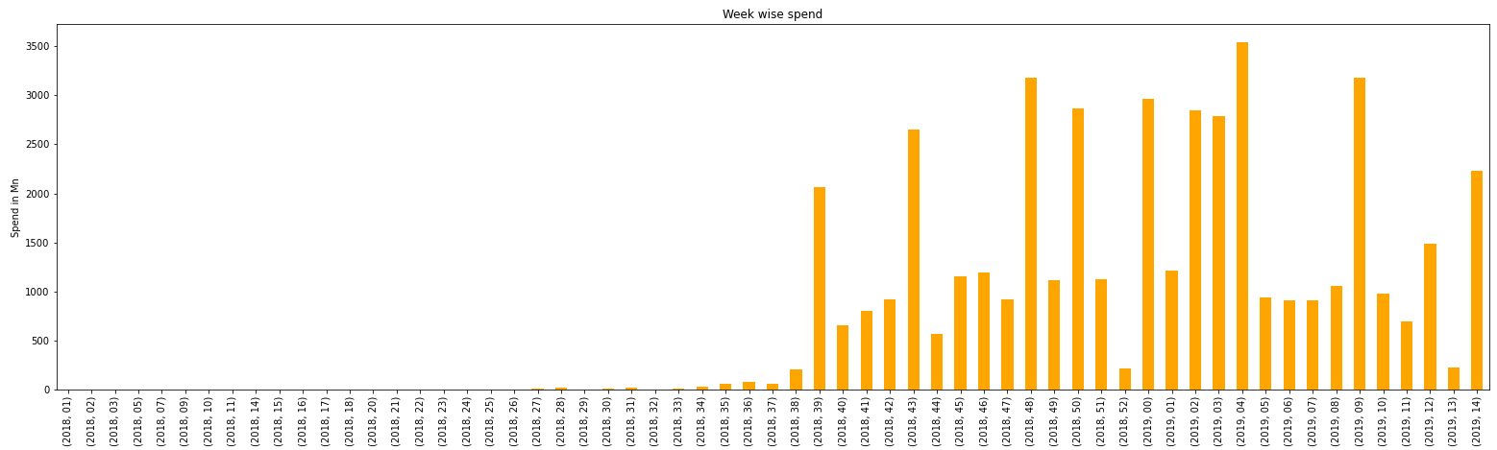
Week wise spend
Though no of spend are high in some weeks, its spend amount is less

Slide 20
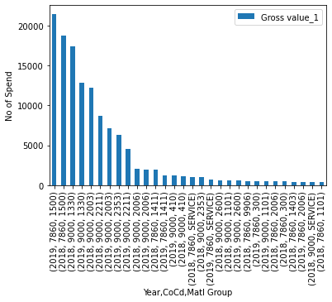
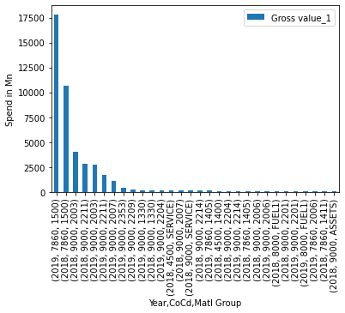
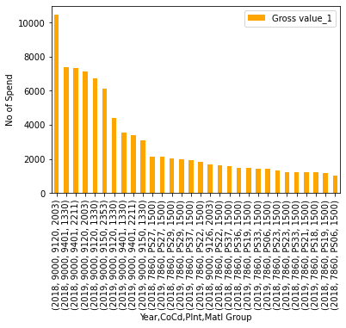
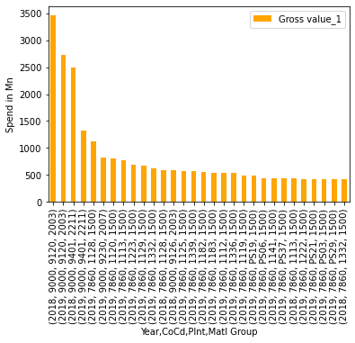
Matl Group-Year wise spend
Matl Group 1500 has highest contribution but 2003 Matl group contribution is more when we consider Plnt

Slide 21
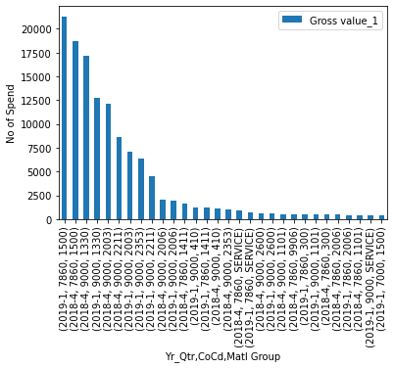
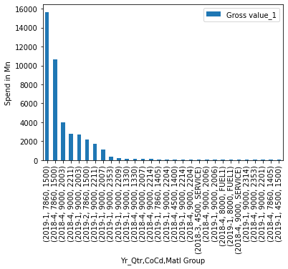
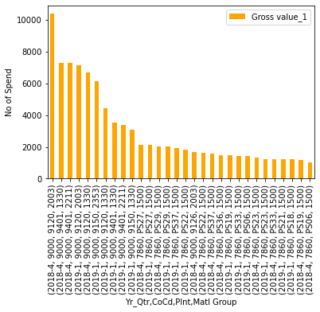
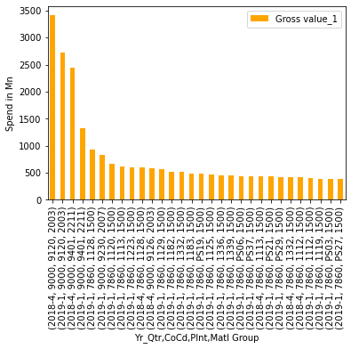
Matl Group-Year-Qtr wise spend
Matl Group 1500 has highest contribution but 2003 Matl group contribution is more when we consider Plnt
Maximum spend observed in 2018 Q4 and 2019 Q1

Slide 22
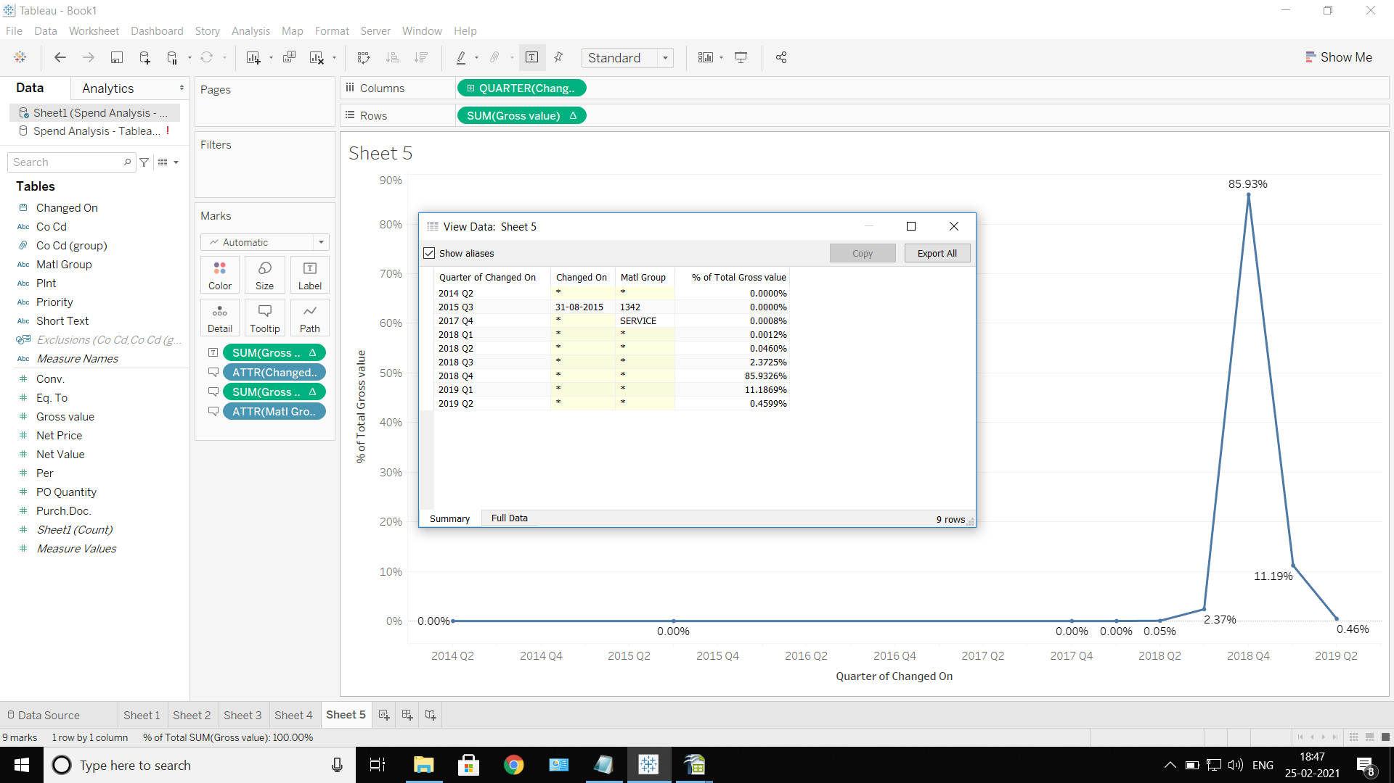
Year wise spend for 7860 and 9000
Spend of CoCd 7860 & 9000 was observed to be more in the years 2018 and 2019.

Slide 23
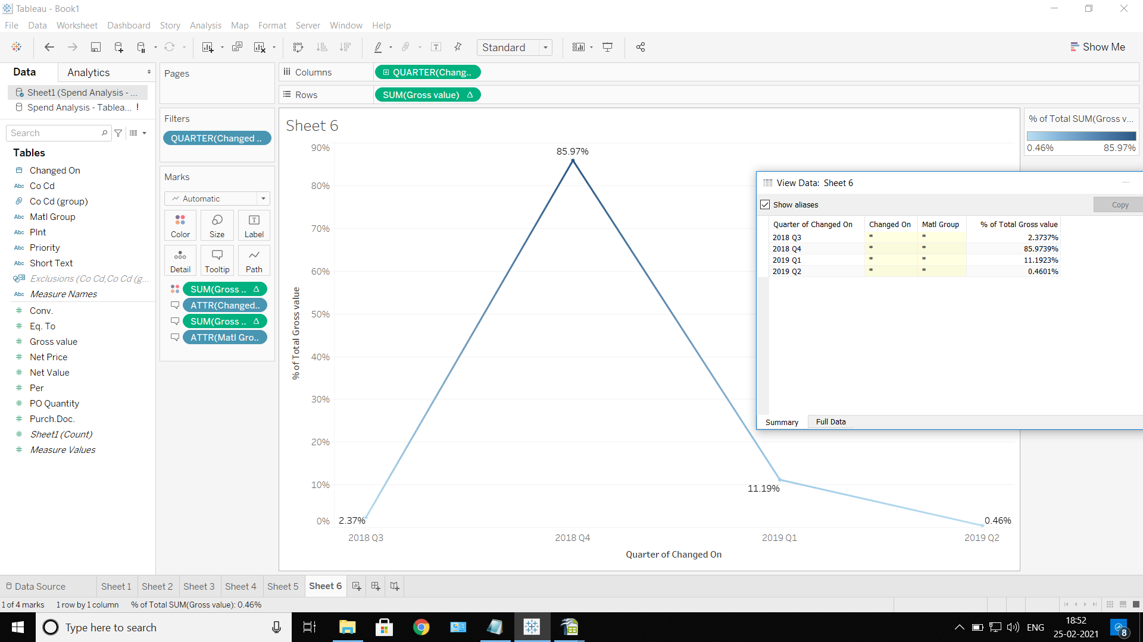
Spend-2018 and 2019
Further drill down of previous slide showing Percentage Quarter wise.

Slide 24
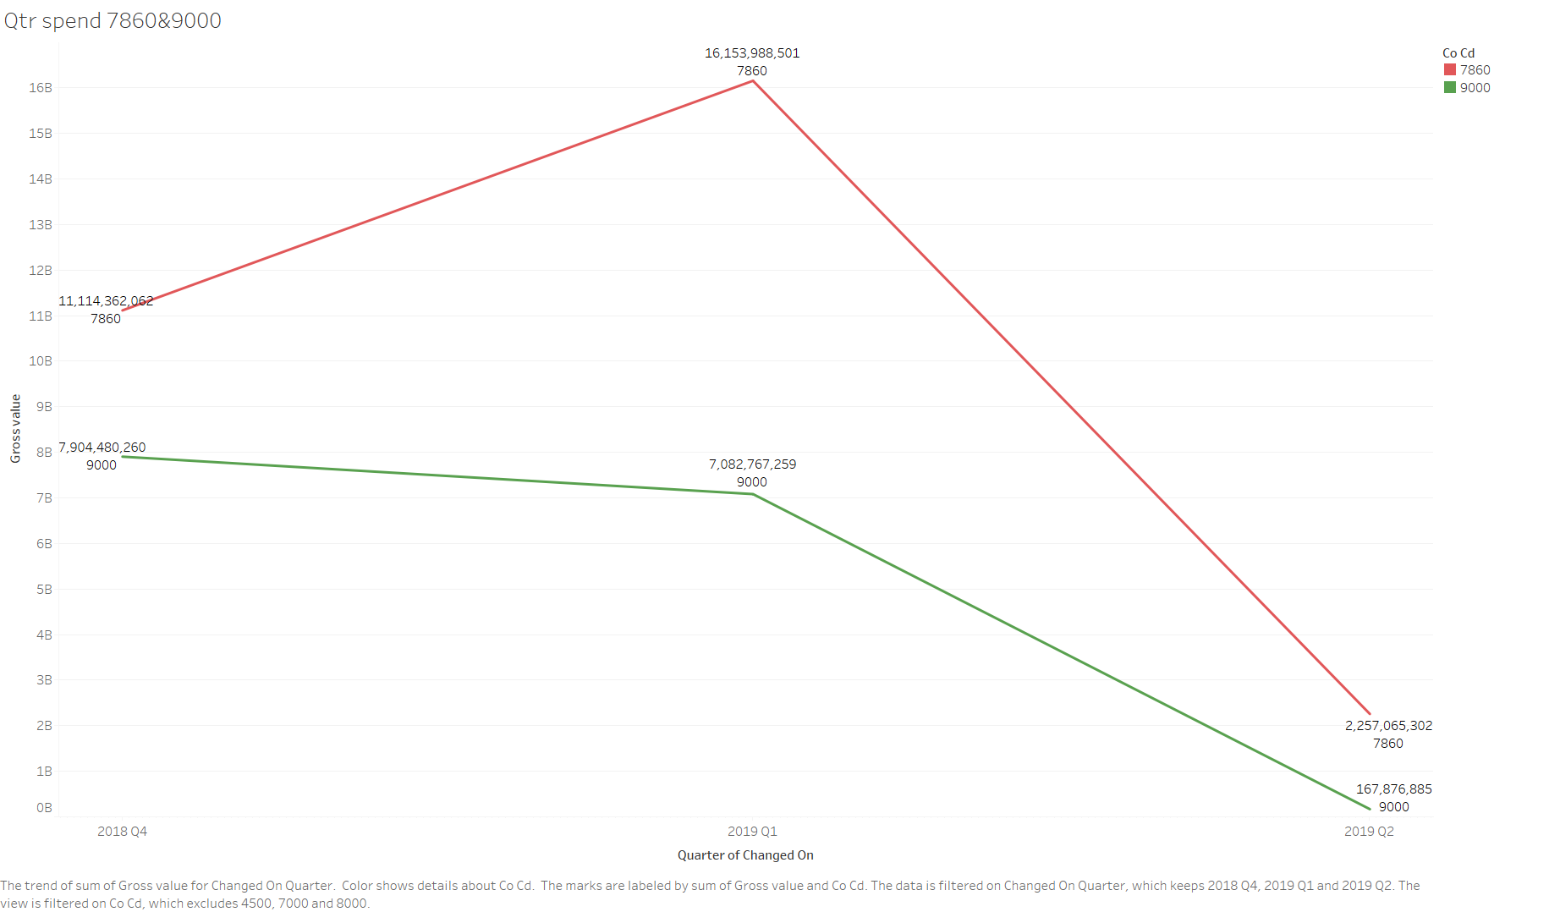
Quarter wise Contribution-7860 and 9000
7860 Cocd had more spent compared to 9000

Slide 25
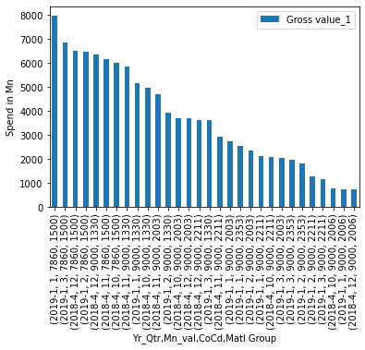
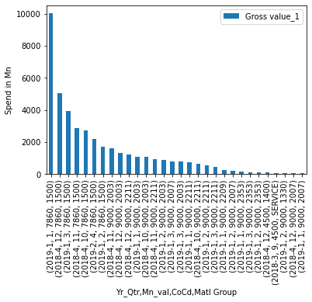
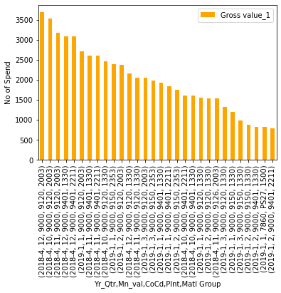

Matl Group-Qtr-Month wise spend
Matl Group 1500 has highest contribution but 2003 Matl group contribution is more when we consider Plnt

Slide 26

Week wise spend-7860 Cocd
Week wise spend analysis for Q4-2018 & Q1-2019 – Showing peaks during last and first weeks of the month

Slide 27

Week wise spend-7860 Cocd on Matl group 1500
On further drill down of the above data, we observed that the spend trend peaked up to 65% on Tuesdays and 25% on Thursdays.

Slide 28




Matl Group-Qtr_week wise spend
Matl Group 1500 has highest contribution but 2003 Matl group contribution is more when we consider Plnt

Slide 29




Matl Group-Qtr_Day wise spend
Matl Group 1500 has highest contribution but 2003 Matl group contribution is more when we consider Plnt

Slide 30


Short Text with Highest contribution in a Day
soya crude oil – purchase has highest spend in a Day from CoCd 9000_Plnt 9230

Slide 31

Short Text wise inference for Cocd 7860 -1500
Short-text wise purchase of the material group indicating that Feed P1 and Grand Parents Layer played a major contributor role in the spend.

Slide 32

Month wise drill down of Plant 1128 spend short-text wise:
Feed P1 and Grand Parents Layer contributed to major spend cumulatively for both the quarters.

Slide 33

Plant wise spend
The analysis on which Plant code contributed to maximum purchase on the 1500 Material group resulted in identifying that Plant 1128 made consistent purchase for both the quarters.

Slide 34
Observation Summary - EDA
7860 | 9000
Contributed to 64% of the overall Gross value Of the overall spend – 99.69% of the spend is on the Material Group 1500 Maximum spend was observed in Q4 of 2018 and Q1 of 2019 It has been observed that on an average, the Spend trend peaked during the last and first week on the months. The maximum spend was observed on Tuesdays contributing to more than 65% followed by Thursdays. (Maybe they place the order for feed every Tuesday. This is just hypothetical) Further drill down on the data based on Plant code and Short text was made and shown in the Visualization | Contributed to 34% of overall Gross value The Overall spend was shared between three Material groups – 2003,2211 & 2007 Maximum spend was observed in Q4 of 2018 and Q1 of 2019 No inference on the week wise trend for 9000 for any of the material group. Nothing which is significant has been observed. The spend is distributed between Monday, Wednesday and Saturday. But no peaks hence not considering as significant Since the contribution was not considered significant, the drill down with respect to Plant code and Short text has not been taken.

Slide 35
Recommendations to Business:
As per the data analysed, we recommend that the Purchase can be done once in a month (preferably in the beginning of the month, since the rates spike is predominantly increasing).
Since the Purchase quantity is high for the Feed materials in 1500 we recommend that we can reduce the Logistic cost if the Order is placed from 1 single plant and by placing the order once a month instead of repeated orders of same materials.
If the Products of Storable (Like Maize and other Feed products) we can order them in Bulk with good negotiations (Min 1% to 5 %) which actually reduces the spend cost significantly.

Slide 36
Summary
Understood the important variables
Pre-processing done to proceed further analysis of our data
EDA done for our data to understand the different trends of spend
Cost opportunities identified as part of prescription statistics
Employed KPrototyes clustering techniques for clustering our data and understood different clusters of our data
Employed ARIMA model for forecasting of future trend as per current spend (6 months data)

Slide 37
Additional Supportive Informational Slides

Slide 38

Material Group Type(New Column) – Spend Analysis – Major contributors are 7860 and 9000

Slide 39

Material wise spend showing the major trend on 1500, 2003,2007 & 2211

Slide 40

Material 1500-CoCd wise spend
Year Wise Spend – Spend of CoCd 7860 & 9000 was observed to be more on Q4-2018 & Q1-2019

Slide 41
Thank You

